Slide 1
Water Tank Figures

Slide 2
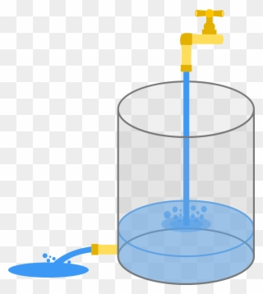
Inflow
Water Level: wl
Outflow

